Slide 1
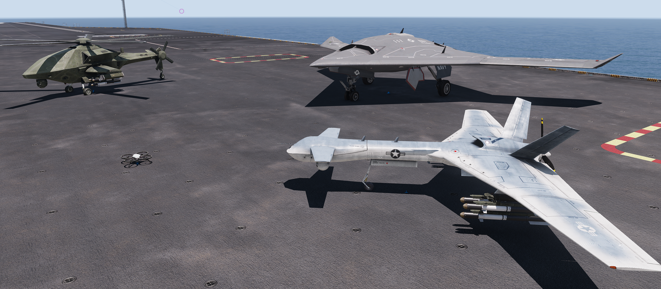
PROJECT REVIEW AND FEEDBACK IDS 6916 – Simulation Research Methods & Practicum - FALL 2018 (BY DR. KIDER)
HUMAN-ASSISTED WEAPON SYSTEMS
CABRERA, Roberto & UYSAL, Ugur
ArmA 3 ingame Screenshot
Notes:
Video X-47B Completes First Carrier-based Arrested Landing
Video UCAV Landing Simulation

Slide 2
Topic / Purpose Statement
The validity of human-autonomy teaming on the battlefield in the near future.
The purpose of this exploratory research is to create a framework using ARMA 3 as a modeling and simulation platform to conduct further experimentation on the human-autonomy teaming on the battlefield .
Notes:
This study addresses the validity of human-autonomy teaming on the battlefield in the near future. The purpose of this exploratory research is to create a framework using ArmA 3 as a modeling and simulation platform to conduct further experimentation on the subject. The first phase of the study will be a qualitative exploration of the human-autonomous teaming to gathered data and knowledge to ascertain the near future prospects. The data will help in the design of more realistic scenarios that will allowed us to conduct quantitative experiments using ArmA 3. The data is collected from the literature review and interviews with subject matter experts (SME). From the initial exploration, the qualitative findings will be used to develop a quantitative experimentation on a human subject interacting with semi-autonomous entities. In the tentative planned quantitative phase, reliability data will be collected from experiments conducted using ArmA 3

Slide 3
Introduction
Armed forces use technology to gain superiority on the battlefield. Recent breakthroughs in the field of Artificial Intelligence (AI) and Unmanned Systems provide new uses for military operations. The focus of this research is the Human-autonomy teaming approach. With our research we would like to investigate the possibilities to operate unmanned systems autonomously, to increase the effectiveness of military forces on the near future battlefield.
Notes:
Armed forces use technology to gain superiority on the battlefield. Recent breakthroughs in the field of Artificial Intelligence and Unmanned Systems provide new uses for military operations. The Control of Unmanned Systems can be done at different levels of autonomy. The focus of this research is the Human-autonomy teaming approach. In contrast to Manned-unmanned teaming, the unmanned systems are not operated by human operators. With our research we would like to investigate the possibilities to operate unmanned systems autonomously, to increase the effectiveness of military forces on the near future battlefield
Video of the Landing
“Its Real” What else is possible?
REAL Landing / Simulated Video max 30.

Slide 4
Related works / literature review
Breakthroughs in AI and Robotics
Level of autonomy:
- Semiautonomous (human in the loop)
- Supervised autonomous (human on the loop)
- Fully autonomous (human out of the loop)
Military potential of Human-autonomy teaming
- Reliability of autonomous systems
- Cognitive load of the human-superviser
- Ethical and legal aspects
Notes:
When searching for literature on the topic of Human-assisted Weapon Systems, we mostly found terms such as Manned-unmanned teaming and Human-autonomy teaming. It is striking that the term Human-autonomy teaming is used more frequently in the latest publications. This is related to advances in the field of autonomous systems in recent years and the resulting potential in the military sector. Manned-unmanned teaming is the collaboration between a system of human inmates and a human remote controlled system without human occupants. In Human-autonomy teaming, the unmanned system is autonomously controlled by an agent or AI and is not remotely controlled by a human operator.

Slide 5
Research Method
We want to use a Mixed Methods Approach to answer the following Research Questions:
1st Step: Qualitative research questions
- literature review
- interviews
2nd Step: Quantitative research question
- simulation experiments.

Slide 6
Qualitative Research Questions
Central question: What are the benefits of using human-supervised autonomous systems in a military environment?
Subquestion 1: What is the current status of research on Human-autonomy teaming in the military?
Subquestion 2: How could autonomous systems be integrated into the armed forces, ensuring that legal aspects are adhered to?

Slide 7
Qualitative Research Questions (Central Question)
What are the benefits of using human-supervised autonomous systems in a military environment?
Increase in lethality.
Survivor evacuation support.
Reduce human exposure to combat.
Reduction of cost, labor and personnel.
Improve safety.
No human limitations.
Notes:
The military is looking into increasing their capabilities star introducing unmanned vehicles (UVs) and robotic systems (Squire & Parasuraman, 2010) (de Visser & Parasuraman, 2011) (Chen & Barnes 2014). The factors driving the introduction of UVs to increase force lethality, survivor evacuation, and reducing human exposure to combat operations (Chen & Barnes 2014). Other factors are the reduction in personnel, reduction in labor cost, improve human safety and cost-saving ways to perform tasks without the human limitations and expense (Squire & Parasuraman, 2010) (Endsley, 2017). The literature provides some evidence where the use of human-supervised autonomous has been beneficial.

Slide 8
Qualitative Research Questions (Subquestion 1)
What is the current status of research on Human-autonomy teaming in the military?
Current research being performed on the subjects of:
Dismounted infantry working with small robots
Intelligent analysis
human working with intelligent agents managing teams of unmanned vehicles (human-automation teaming)
vehicles with ground penetrating radars
human-automation teaming the behavior and the synchronization between teams
the cognitive load of the human agent and how to decrease it.
Notes:
Current research being performed on the subject of dismounted infantry working with small robots, intelligent analysis, human working with intelligent agents managing teams of unmanned vehicles, vehicles with ground penetrating radars (Chen, 2018). Most of the research perform into the efficacy Some research perform in human-automation teaming is looking at the behavior and the synchronization between teams (Demir, McNeese, and Cooke, 2018). There are a number of research being conducted in the field of human-autonomy systems. Some of the research concentrate on the cognitive load of the human agent and how to decrease it.

Slide 9
Qualitative Research Questions (Subquestion 2)
How could autonomous systems be integrated into the armed forces, ensuring that legal aspects are adhered to?
Humans still understand patterns behavior, human intentions, macro implications and ethical responsibilities much better than artificial systems
The system autonomous agent shall always remain subordinate to their human counterparts
The human will only be allowed the agent to act autonomously only specified conditions
Developing a matrix defining the level of automation to be use. These rules would be embedded base on legal and rules of engagement.
Notes:
The suggestion for autonomous systems to ensure they adhered to legal implication is to rest the authority on a human supervisor (Chen & Barnes 2014). Humans still understand patterns behavior, human intentions, macro implications and ethical responsibilities much better than artificial systems (Chen & Barnes 2014). For this reason, the system autonomous agent shall always remain subordinate to their human counterparts (Chen & Barnes 2014). The human will only be allowed the agent to act autonomously only specified conditions (Chen & Barnes 2014). John H. Northrop and Associate conducted a study which suggests developing a matrix defining the level of automation (Chesebrough & Dooley, 2018). This matrix should provide the need and level of autonomous tactical needed to accomplish the mission within the constraints of mission parameters (Chesebrough & Dooley, 2018). The literature has provided a number of solutions to integrate rules of engagement, ethical and legal tenants.

Slide 10
Quantitative Research Questions
Does the use of autonomous systems have positive effects on military capabilities?
Hypothesis 1: Unmanned Systems can be operated autonomously with the same reliability as Human-operated once in a virtual military scenario.
Hypothesis 2: By using autonomous systems, military missions can be conducted with less human personnel.
Hypothesis 3: The use of autonomous systems could extend the range of military operations.
Notes:
The execution of hypothesis 2 and hypothesis 3 depends on the result of hypothesis 1.

Slide 11
Preliminary framework / setup
Experimental Study Method Plan
Participants: Group4
Independent variables (…):
- Level of autonomy {semi-,supervised-, fully-autonomous}
- Amount of targets {1..n}
- Complexity of Szenario {low, middle, high}
Dependent variables (…):
- % of destroyed targets
- Mission Time
- Perception of the cognitive workload of the human operator
Instrumentation and Materials: Military tactical shooter video game ArmA 3

Slide 12
Preliminary framework / setup
Experimental Procedures Hypothesis 1:
Setting up the Scenario
According to the independent variables
2. Conducting simulation experiments
A: semi-autonomous operation (30 runs)
B: supervised autonomous operation (30 runs)
3. Analyzing the Data.
Statistical hypothesis test using the software "R“ to compare results of the experiment A and B.
Notes:
Video semi-autonomous operation
Video supervised autonomous operation

Slide 13
Early Results Hypothesis 1
Hypothesis 1: Unmanned Systems can be operated autonomously with the same reliability as Human-operated once in a virtual military scenario.
After analyzing early results, there is evidence that there is no significant difference between the results of experiment A and B. That means unmanned Systems can be operated autonomously with the same Reliability as Human-operated once in a ArmA 3-based virtual military scenario.
Notes:
+ Data Visualization

Slide 14
Plan of attack for the rest of the semester
Midterm presentation 10/30/2018
Update GitHub with slide content NLT 10/23/2018
Draft slides uploaded NLT 10/23/2018
Final slides uploaded NLT 10/29/2018
Draft early results of qualitative and quantitative NLT 10/22/2018
Final presentation 12/04/2018
Finalize research methodologie NLT 11/29/2018
Qualitative research finalized NLT 11/29/2018
Quantitative research finalized NLT 11/29/2018
Finalize documentary NLT 12/03/2018

Slide 15
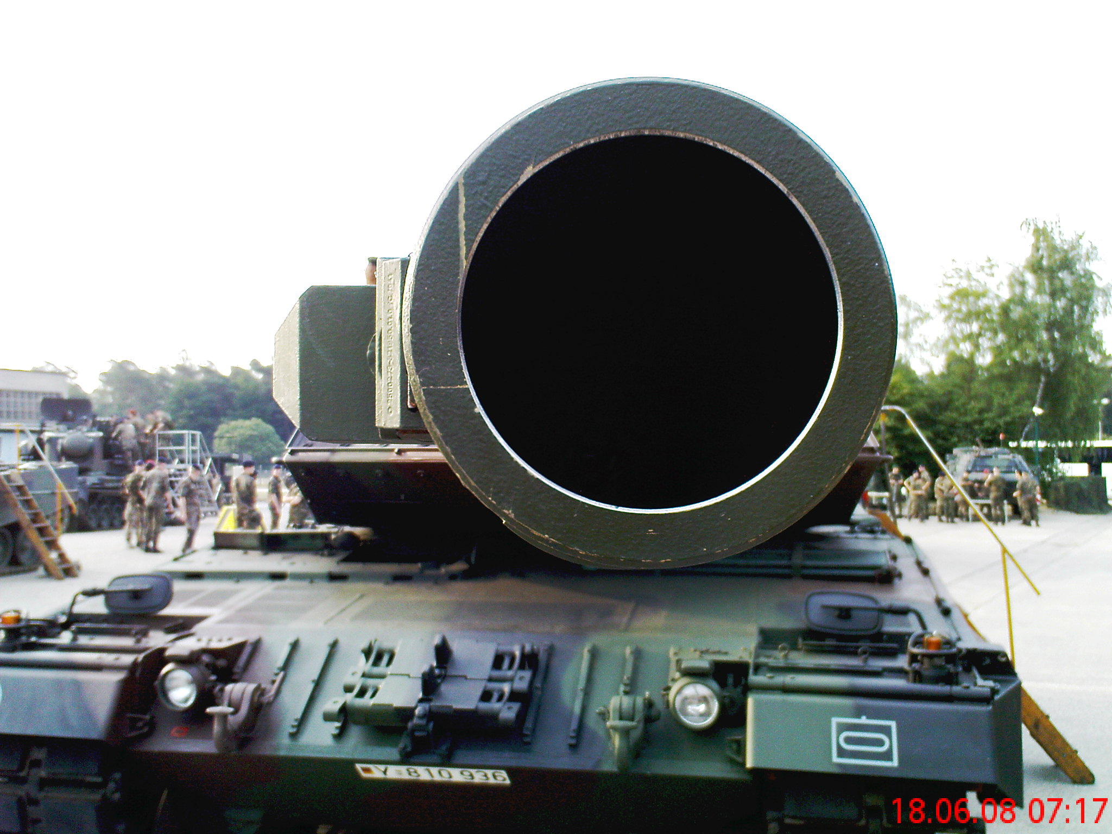
Questions?

Slide 16
References
Chen, J. Y., & Barnes, M. J. (2014). Human–agent teaming for multirobot control: A review of human factors issues. IEEE Transactions on Human-Machine Systems, 44(1), 13-29.
Chen, J. Y. (2018). Human-autonomy teaming in military settings. Theoretical Issues in Ergonomics Science, 19(3), 255-258.
Chen, J. Y., Lakhmani, S. G., Stowers, K., Selkowitz, A. R., Wright, J. L., & Barnes, M. (2018). Situation awareness-based agent transparency and human-autonomy teaming effectiveness. Theoretical issues in ergonomics science, 19(3), 259-282.
Chesebrough, D., & Dooley, M. (2018, September 13). Defense Department Struggles to Define Autonomy. Retrieved from http://www.nationaldefensemagazine.org/articles/2018/9/13/defense-department-struggles-to-define-autonomy
de Boisboissel, G. (2017). Is it sensible to grant autonomous decision-making to military robots of the future?. In Military Technologies (ICMT), 2017 International Conference on (pp. 738-742). IEEE.
Defense Science Board. 2016. Defense Science Board Summer Study on Autonomy. Washington, DC:Under Secretary of Defense.
Endsley, M. R. (2017). From here to autonomy: lessons learned from human–automation research. Human factors, 59(1), 5-27.
Demir M., McNeese N.J., Cooke N.J. (2018) Team Synchrony in Human-Autonomy Teaming. In: Chen J. (eds) Advances in Human Factors in Robots and Unmanned Systems. AHFE 2017. Advances in Intelligent Systems and Computing, vol 595. Springer, Cham
Hawking, S. (2014). Transcendence looks at the implications of artificial intelligence—but are we taking AI seriously enough? The Independent.
Millington, I., & Funge, J. (2009). Artificial intelligence for games. CRC Press.
Reuters (2018, September 19). Ageing Japan: Military recruiters struggle as applicant pool dries up. Retrieved from https://in.reuters.com/article/japan-ageing-military-recruits/ageing-japan-military-recruiters-struggle-as-applicant-pool-dries-up-idINKCN1LZ146
Sadraey, M. H. (2018). Manned-unmanned aircraft teaming. In 2018 IEEE Aerospace Conference (pp. 1-12). IEEE.
Scharre, P. (2018). Army of None: Autonomous Weapons and the Future of War. WW Norton & Company.
Squire, P. N., & Parasuraman, R. (2010). Effects of automation and task load on task switching during human supervision of multiple semi-autonomous robots in a dynamic environment. Ergonomics, 53(8), 951-961.
Vinge, V. (1993). The coming technological singularity: How to survive in the post-human era.
Warren, A., & Hillas, A. (2017). Lethal Autonomous Weapons Systems: Adapting to the Future Unmanned Warfare and Unaccountable Robots. Yale J. Int'l Aff., 12, 71.
Yilmaz, L., Ören, T., & Aghaee, N. G. (2006). Intelligent agents, simulation, and gaming. Simulation & Gaming, 37(3), 339-349.
Youtube (2013, July 10). X-47B Completes First Carrier-based Arrested Landing. Retrieved from https://www.youtube.com/watch?v=Rc2k6G8LuqY

